Slide 1
IS 466 Decision Support Systems
Lecture 2
Data warehousing

Slide 2
What is Data Warehouse?
“A data warehouse is a subject-oriented, integrated, time-variant, and non volatile collection of data in support of management’s decision-making process.” W. H. Inmon
  - Subject-Oriented: Organized around major subjects, such as product, sales
  - Integrated: Constructed by integrating multiple, heterogeneous data sources - relational databases, flat files
    -Time Variant: Data warehouse data provide information from a historical perspective (e.g., past 5-10 years). It contains an element of time, explicitly or implicitly
    - Non-Volatile: Requires only two operations in data accessing:
    initial loading of data and querying (read)
IS 466 – Data Warehousing

Slide 3
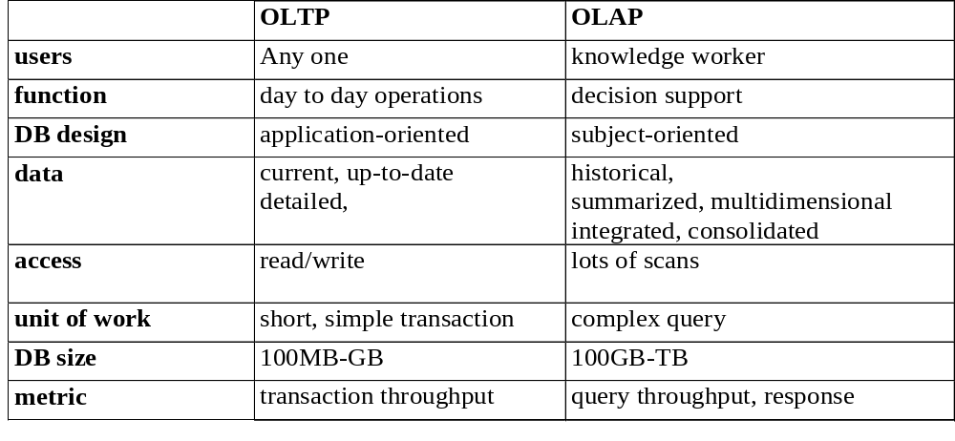
Data Warehouse vs. Operational DBMS
OLTP (on-line transaction processing): Major task of traditional relational DBMS; Day-to-day operations, example purchasing, inventory, banking, …
OLAP (On-Line Analytical Processing): Major task of data warehouse system; used in data analysis and decision making
IS 466 – Data Warehousing -

Slide 4
From tables to Data Cubes
A data warehouse is based on a multidimensional data model which views data in the form of a data cube
A data cube, such as sales, allows data to be modeled and viewed in multiple dimensions
  Dimension tables such as
    item(item_name, type,…)
    time(day, week, month, quarter, year)
    location(location_name, country)
  Fact table contains measures and keys to related dimension tables
IS 466 – Data Warehousing -

Slide 5
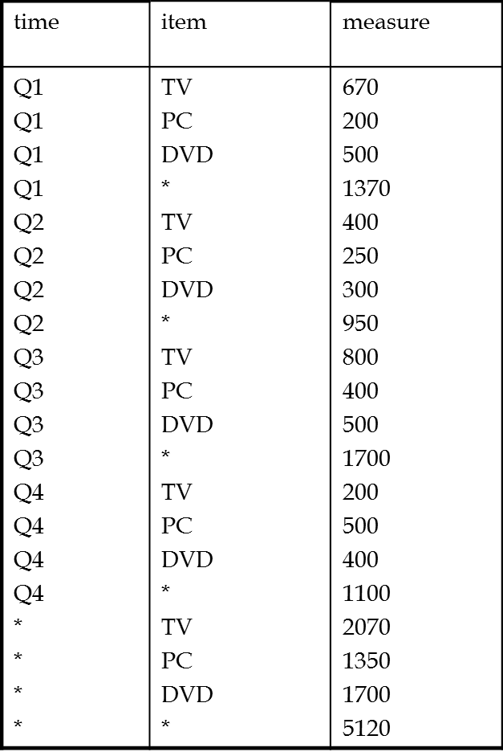
From tables to Data Cubes
2-D view of sales cross-tabulation (pivot table)
Relational representation
of pivot table
Location = « Mekkah »
time | TV PC DVD SUM
Q1 Q2 Q3 Q4 SUM | 670 200 500 1370 400 250 300 950 800 400 500 1700 500 400 1100 2070 1350 1700 5120
item
IS 466 – Data Warehousing -

Slide 6

From tables to Data Cubes
3-D view of sales cube
Date
1Qtr
2Qtr
3Qtr
4Qtr
sum
Product
TV
PC
Mekkah
DVD
sum
Madinah
City
Quds
sum
All, All, All
IS 466 – Data Warehousing -

Slide 7
Cube: A lattice of Cuboids
all
0-D(apex) cuboid
product
date
city
1-D cuboids
product,date
product,city
date, city
2-D cuboids
3-D(base) cuboid
product, date, city
IS 466 – Data Warehousing -

Slide 8
Cube: A lattice of Cuboids
all
0-D(apex) cuboid
time
item
city
supplier
1-D cuboids
time,item
time, city
item, city
city,supplier
2-D cuboids
time,supplier
item,supplier
time, city,supplier
time,item, city
3-D cuboids
time,item,supplier
item, city,supplier
4-D(base) cuboid
time, item, city, supplier
IS 466 – Data Warehousing -

Slide 9
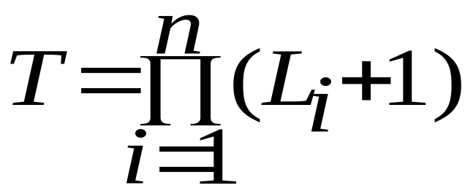
Cube: A lattice of Cuboids
How many cuboids (T) in an n-dimensional cube with L levels?
If n=10 and each dimension has one level then
T= (1+1)¹⁰
If n=10 and each dimension has 4 levels then
T= (4+1)¹⁰
IS 466 – Data Warehousing -

Slide 10
Relational Data Modeling of Data Warehouses
Modeling data warehouses: dimensions & measures
Star schema: A fact table in the middle connected to a set of dimension tables
Snowflake schema: represents dimensional hierarchy by normalizing the dimension tables (i.e., each level of a dimension represented in one table)
Fact constellations: Multiple fact tables share dimension tables
IS 466 – Data Warehousing -

Slide 11
Example of Star Schema
time
time_key
day
day_of_the_week
month
quarter
year
item
item_key
item_name
brand
type
supplier_type
Sales Fact Table
time_key
item_key
branch_key
branch
location
location_key
branch_key
branch_name
branch_type
location_key
street
city
state_or_province
country
units_sold
currency_sold
avg_sales
Measures
IS 466 – Data Warehousing -

Slide 12
Example of Snowflake Schema
This is not a full snowflake schema
time
item
time_key
day
day_of_the_week
month
quarter
year
item_key
item_name
brand
type
supplier_key
supplier
Sales Fact Table
supplier_key
supplier_type
time_key
item_key
branch_key
branch
location
location_key
location_key
street
city_key
branch_key
branch_name
branch_type
units_sold
currency_sold
city
city_key
city
state_or_province
country
avg_sales
Measures
IS 466 – Data Warehousing -

Slide 13
Example of Fact Constellation
time
time_key
day
day_of_the_week
month
quarter
year
item
Shipping Fact Table
item_key
item_name
brand
type
supplier_type
Sales Fact Table
time_key
time_key
item_key
shipper_key
item_key
branch_key
from_location
branch
location_key
location
to_location
branch_key
branch_name
branch_type
units_sold
location_key
street
city
province_or_state
country
currency_cost
currency_sold
units_shipped
avg_sales
shipper
Measures
shipper_key
shipper_name
location_key
shipper_type
IS 466 – Data Warehousing -

Slide 14
Defining a Star Schema in DMQL
define cube sales_star [time, item, branch, location]:
    currency_sold = sum(sales_price),
    avg_sales = avg(sales_price),
    units_sold = count(*)
define dimension time
as (time_key, day, day_of_week, month, quarter, year)
define dimension item
as (item_key, item_name, brand, type, supplier_type)
define dimension branch
as (branch_key, branch_name, branch_type)
define dimension location
as (location_key, street, city, province_or_state, country)
IS 466 – Data Warehousing -

Slide 15
Defining a Snowflake Schema in DMQL
define cube sales_snowflake [time, item, branch, location]:
    currency_sold = sum(sales_price),
    avg_sales = avg(sales_price),
    units_sold = count(*)
define dimension time
as (time_key, day, day_of_week, month, quarter, year)
define dimension item
as (item_key, item_name, brand, type,
supplier(supplier_key, supplier_type))
define dimension branch
as (branch_key, branch_name, branch_type)
define dimension location
as (location_key, street, city(city_key, province_or_state, country))
IS 466 – Data Warehousing -

Slide 16
Multidimensional Data
Dimensions are : product, month, region
Measure is sales_amount
Hierarchical summarization paths
Region
Industry Region Year
Category Country Quarter
Product City Month Week
Office Day
Product
Month
IS 466 – Data Warehousing -

Slide 17
An example of Data Cube
Date
Total annual sales
of TV in Mekkah
1Qtr
2Qtr
3Qtr
4Qtr
sum
Product
TV
PC
Mekkah
DVD
sum
Medinah
City
Quds
sum
All, All, All
IS 466 – Data Warehousing -

Slide 18
OLAP operations
Roll up (drill-up): summarize data by climbing up hierarchy or by dimension reduction
Drill down (roll down): reverse of roll-up
  from higher level summary to lower level summary or detailed data, or introducing new dimensions
Slice and dice: project and select
Pivot (rotate): reorient the cube, visualization, 3D to series of 2D planes.
IS 466 – Data Warehousing -

Slide 19
OLAP operations and SQL
Simple star schema
time
product
time_key
month
quarter
year
item_key
name
type
Sales Fact Table
time_key
item_key
location
location_key
location_key
city
state
country
qsales
IS 466 – Data Warehousing -

Slide 20
Creation of tables
create materialized view product as
select name, type
from ‘DB1’.product
create materialized view location as
select city, state, country
from ‘DB2’.location
create materialized view time as
select month, quarter, year
from ‘DB3’.time
IS 466 – Data Warehousing -

Slide 21
Data Cube
Total annual sales
of TV in Mekkah
time
Jan
Apr
Jul
Oct
sum
Product
TV
PC
Mekkah
DVD
sum
Medinah
location
Quds
sum
IS 466 – Data Warehousing -

Slide 22
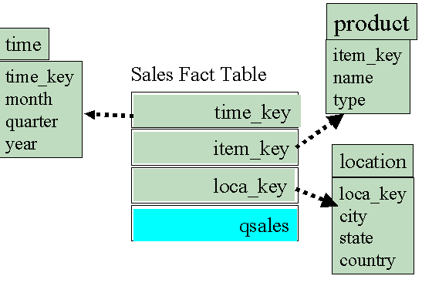
Roll up query
Consider roll up query is created as follows
month➔quarter
  create view salesQuarter as
  select quarter, year, item_key, location_key, sum(qSales)
  from sales S, time T
  where S.time_key = T.time_key
  group by year, quarter, item_key, location_key
Drill down(quarter➔month)
  Use of salesQuarter, sales (provides qSales) and time dimension
IS 466 – Data Warehousing -
Notes:
city➔country
create view salesCity as
select state, country, item_key, time_key, avg cSale , sum(qsales)
from sales S, location L
where S.location_key = L.loca_key
group by country, state, item_key, time_key
In order to provide three dimensions we have to concatenate quarter and year in one string.

Slide 23
Slice query
create view sliceView as
select time_key, item_key, location_key, qsales
from sales S
where S.time_key = 2008
order by item_key, location_key
IS 466 – Data Warehousing -

Slide 24
Dice query
create view diceView as
select time_key, item_key, location_key, q_sales
from sliceView
where sliceView.location_key = Riyadh
order by item_key, time_key
IS 466 – Data Warehousing -

Slide 25
Three Data Warehouse Models
Enterprise warehouse: collects all information about subjects (customer, products, sales, assets, personnel) that span the entire organization
  Requires extensive business modeling
  May take years to design and build
Data Mart: Departmental subsets that focus on selected subjects: Marketing data mart: customer, product, sales
  Faster roll-out
  Complex integration in the long term
Virtual warehouse
  A set of views over operational databases
  Only some of views may be materialized
IS 466 – Data Warehousing -
Notes:
Rollout Products on low prices on name brand home and garden products from online stores.

Slide 26
OLAP Server Architectures
Relational OLAP (ROLAP):
  Leaves detail values in the relational fact table
  Stores aggregated values in the relational database as well.
Multidimensional OLAP (MOLAP)
  Stores both detail and aggregated within the cube.
Hybrid OLAP (HOLAP):
  Leaves detail values in the relational fact table
  Stores aggregated values in the cube.
IS 466 – Data Warehousing -

Slide 27
OLAP Server Architectures
ROLAP
HOLAP
MOLAP
Map
Map
Map
Detail
Detail
Detail
Aggregated
values
Aggregated
values
Aggregated
values
IS 466 – Data Warehousing -

Slide 28

Efficient Data Cube Computation
Data cube can be viewed as a lattice of cuboids
  The bottom-most cuboid is the base cuboid
  The top-most cuboid (apex) contains only one cell
  How many cuboids in an n-dimensional cube with L levels?
Materialization of data cube
  Materialize every (cuboid) (full materialization),
  None: (no materialization),
  or some (partial materialization)
    Selection of which cuboids to materialize - Based on size, sharing, access frequency, etc.
IS 466 – Data Warehousing -
Notes:
In data warehouses, materialized views can be used to precompute and store aggregated data such as sum of sales. Materialized views in these environments are typically referred to as summaries since they store summarized data. They can also be used to precompute joins with or without aggregations.
Materialized views are disk based and are updated periodically based upon the query definition.
Views are virtual only and run the query definition each time they are accessed.

Slide 29
Cube Operation
Cube definition and computation in DMQL
Define cube sales[item, city, year]: sum(sales_in_currency)
compute cube sales
Transform it into a SQL-like language (with a new operator cube by -Gray et al.’96-)
    SELECT item, city, year, SUM (sales_in_currency)
    FROM SALES
    CUBE BY item, city, year
Need compute the following Group-Bys
    ( item, city, year),
    (item, city),(item, year), (city, year),
    (item), (city), (year)
    ()
()
(item)
(city)
(year)
(item,city)
(item, year)
(city, year)
(item, city, year)
IS 466 – Data Warehousing -

Slide 30
Partial materialization
(choose view to answer a query)
Identify all of the materialized cuboids that may potentially be used to answer a query.
Pruning the above set using knowledge of dominance relationship among cuboids.
Estimating the costs of using the remaining materialized cuboids and selecting the cuboid with the least cost.
IS 466 – Data Warehousing -

Slide 31
Partial materialization
(choose view to answer a query)
Define cube sales[year, product, location]: sum(sales_in_currency)
Dimension hierarchies used are
item < brand
street < city < state < country
Cuboids are :
cuboid 1: {item, city, year}
cuboid 2: {brand, country, year}
cuboid 3: {brand, state, year}
cuboid 4: {item, state} where year = 2000
Query {brand, state} with year = 2000?
IS 465 – Data Warehousing - Dr. Mourad Ykhlef

Slide 32
Partial materialization
(choose view to answer a query)
Define cube sales[year, product, location]: sum(sales_in_currency)
Dimension hierarchies used are
item < brand
street < city < state < country
Cuboids are :
cuboid 1: {item, city, year}
cuboid 2: {brand, country, year}
cuboid 1 costs the most since item and city are at lower level than brand and state
cuboid 2 can not be used since state < country
Query {brand, state} with year = 2000?
IS 466 – Data Warehousing -

Slide 33
Partial materialization
(choose view to answer a query)
Define cube sales[year, product, location]: sum(sales_in_currency)
Dimension hierarchies used are
item < brand
street < city < state < country
Cuboids are :
cuboid 3: {brand, state, year}
cuboid 4: {item, state} where year = 2000
cuboid 3 is better than cuboid 4 if
there are few year values associated with items
and several items for each brand
cuboid 4 is better than cuboid 3 if
efficient indices are available for cuboid 4.
Query {brand, state} with year = 2000?
IS 466 – Data Warehousing -

Slide 34
Full materialization
Multi-way Array Aggregation for Cube Computation
Partition arrays into chunks (a small subcube which fits in memory).
Compute aggregates in “multiway” by visiting cube cells in the order (1) which minimizes the # of times to visit each cell, and (2) reduces memory access and storage cost.
C
c3
61
62
63
64
c2
45
46
47
48
c1
29
30
31
32
c0
What is the best traversing order to do multi-way aggregation?
B
60
b3
13
14
15
16
44
28
56
b2
9
40
B
24
b1
5
52
36
20
b0
1
2
3
4
a0
a1
a2
a3
IS 466 – Data Warehousing -
A

Slide 35
Full materialization
Multi-way Array Aggregation for Cube Computation
AC
C
c3
61
62
63
64
c2
45
46
47
48
c1
29
30
31
32
c 0
B
60
b3
13
14
15
16
44
B
9
28
56
b2
BC
40
5
24
52
b1
36
20
b0
1
2
3
4
a0
a1
a2
a3
A
Scanning a₀b₀c₀ leads to scan b₀c₀ ,a₀c₀ and a₀b₀ of BC, AC and AB
AB
b₀c₀ = aggregation(1-4)
b₁c₀=aggregation(5-8)
IS 466 – Data Warehousing -

Slide 36
Full materialization
Multi-way Array Aggregation for Cube Computation
AC
C
c3
61
62
63
64
c2
45
46
47
48
c1
29
30
31
32
c 0
B
60
b3
13
14
15
16
44
BC
B
9
28
56
b2
40
5
24
52
b1
36
20
b0
1
2
3
4
a0
a1
a2
a3
A
AB
IS 466 – Data Warehousing -

Slide 37
Full materialization
Multi-way Array Aggregation for Cube Computation
Cuboids are : A, B, C, AB, BC, AC, ABC and Ø
size(A) = 40, size(B)=400, size(C)=4000
The size of each chunk of A, B and C are 10, 100 and 1000
Computation of cuboid BC is done by computing cuboids b_{i}c_{j} .
b₀c₀ is fully aggregated after scanning 1,2,3,4.
  For BC aggregation we scan chunk 1 to 64
Is the computation of cuboids AC et AB, needs scanning of 64 chunks another time? NO
    Scanning of a₀b₀c₀ leads to compute a₀b₀ and a₀c₀ (Multi-way aggregation)
    So by scanning of 64 chunks one time, one can compute 3 cuboides AB, AC and BC
IS 466 – Data Warehousing -

Slide 38
In order to avoid bringing 3-D chunk into memory more than once the minimum memory requirement for holding 2-D plans according to chunk ordering of 1 to 64 is
  40*400 (for AB) + 40*1000 (for one row of AC)
  + 100 * 1000 (for one chunk of BC) = 156 000
If the chunk ordering is 1,17,33,49,5,21,37,53,…the memory requirement is
  400*4000(for BC) + 10*4000 (for one row of CA)
  + 10*100 (for one chunk of AB) = 1 641 000
Limitation of the method: computing well only for a small number of dimensions
  If there are a large number of dimensions, « bottom-up computation » (Beyer & Ramakrishnan, SIGMOD’99) and «iceberg cube computation » methods can be used.
IS 466 – Data Warehousing -

Slide 39
No materialization
Indexing OLAP Data
Bitmap Index
An effective indexing technique for attributes with low-cardinality domains.
Each value in the column has a bit vector
The length of the bit vector: # of records in the base table
Example: attribute gender has value M and F. A table of million people needs 2 lists of million bits.
IS 466 – Data Warehousing -
Notes:
In data warehouses, materialized views can be used to precompute and store aggregated data such as sum of sales. Materialized views in these environments are typically referred to as summaries since they store summarized data. They can also be used to precompute joins with or without aggregations.
When preparing data to be moved into OLAP cubes, the indexing of the dimensions and fact tables in the base data is critically important to the performance of cube processing.
The advantages of using bitmap indexes are greatest for columns in which the ratio of the number of distinct values to the number of rows in the table is small. We refer to this ratio as the degree of cardinality. A gender column, which has only two distinct values (male and female), is optimal for a bitmap index

Slide 40
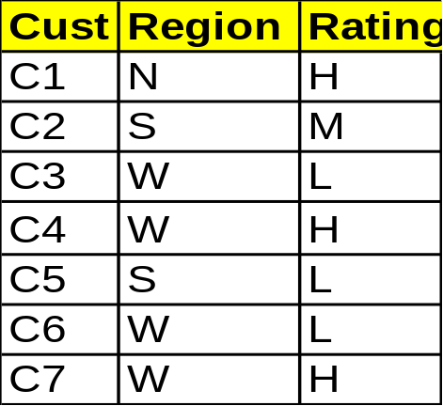
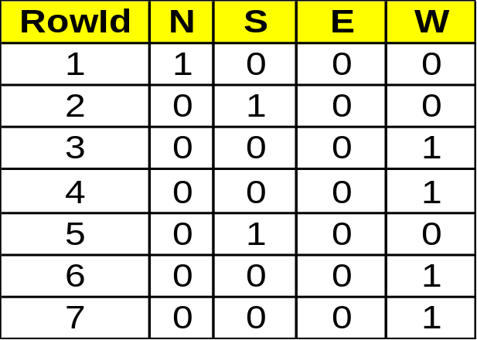
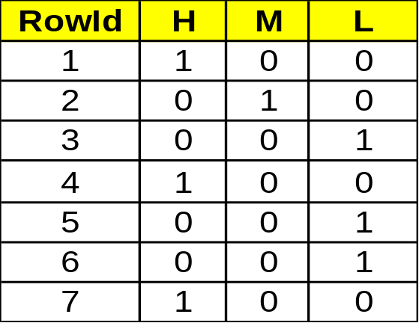
Bitmap Index
base table
Region Index
Rating Index
select cust
from base table
where region=“W” and rating=“L”
IS 466 – Data Warehousing -
Notes:
Index on a particular column
Each value in the column has a bit vector: bit-op is fast
The length of the bit vector: # of records in the base table
The i-th bit is set if the i-th row of the base table has the value for the indexed column
Combine multiple BIs to enable optimized scan of the base table -- How?
this basic scheme is not suitable for high cardinality domains --why?

Slide 41

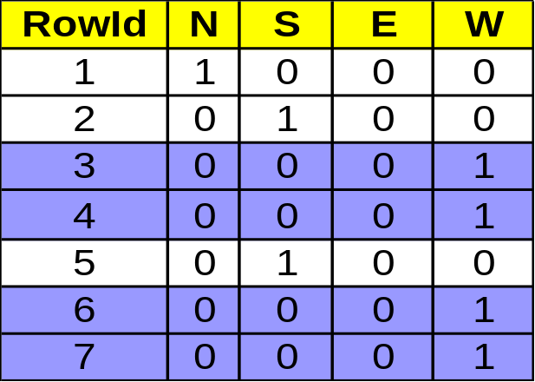
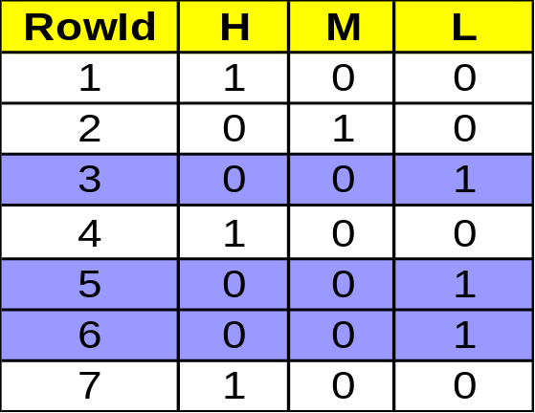
Bitmap Index
base table
Region Index
Rating Index
region=“W” rating=“L”
IS 466 – Data Warehousing -

Slide 42
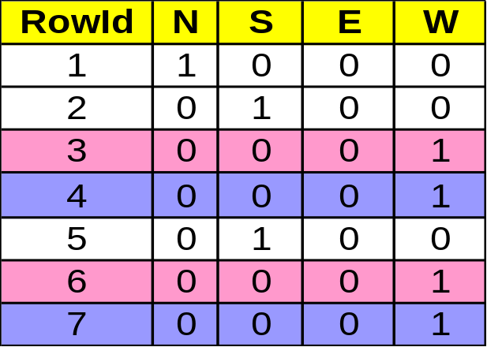
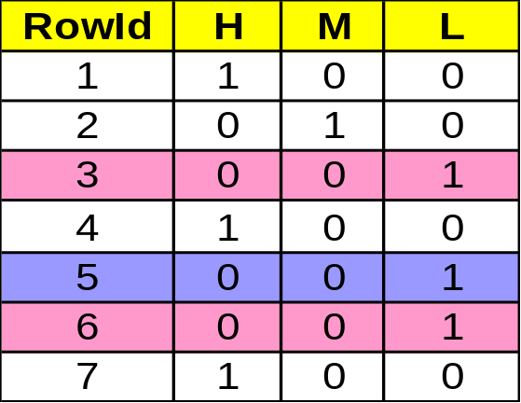
Bitmap Index
base table
Region Index
Rating Index
region=“W” and rating=“L”
IS 466 – Data Warehousing -

Slide 43

Indexing OLAP Data: Join Indices
Traditional indices map the values to a list of record ids
Join index: JI(R-id, S-id) where
R (R-id, …)  S (S-id, …)
In data warehouses, join index relates the values of the dimensions of a star schema to rows in the fact table.
  E.g. fact table: Sales and two dimensions city and product
    A join index on city maintains for each distinct city a list of R-IDs of the tuples recording the Sales in the city
  Join indices can span multiple dimensions-
  can be implemented as bitmap indexes (per dimension) or use bit-op for multiple-joins
Notes:
Join index relates the values of the dimensions of a star schema to rows in the fact table.
Join index: JI(R-id, S-id) where R (R-id, …)  S (S-id, …)
Traditional indices map the values to a list of record ids
It materializes relational join in JI file and speeds up relational join — a rather costly operation
In data warehouses, join index relates the values of the dimensions of a start schema to rows in the fact table.
E.g. fact table: Sales and two dimensions city and product
A join index on city maintains for each distinct city a list of R-IDs of the tuples recording the Sales in the city
Join indices can span multiple dimensions-
can be implemented as bitmap indexes (per dimension) or use bit-op for multiple-joins

Slide 44
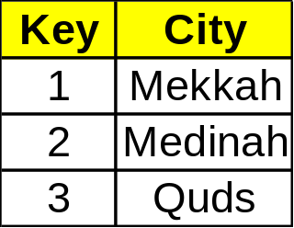
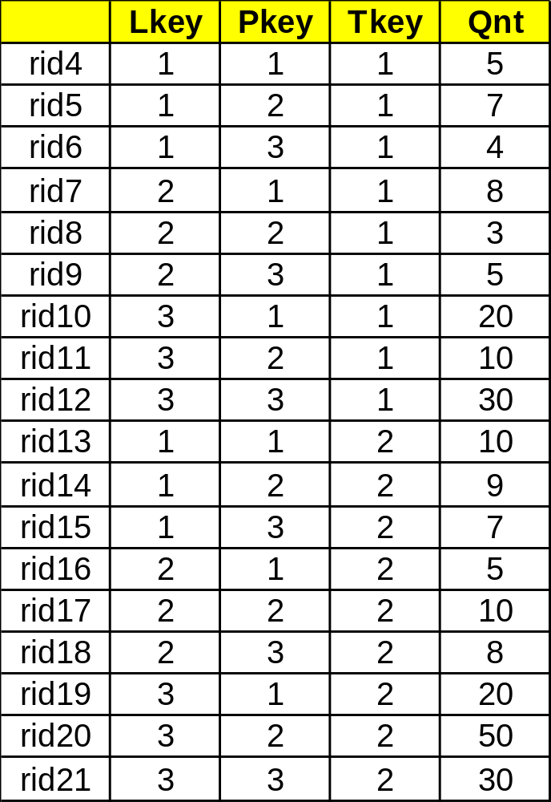
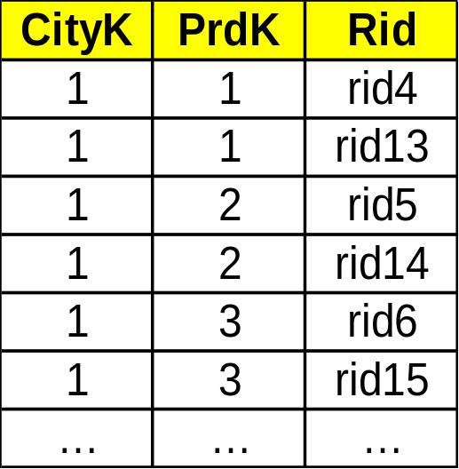
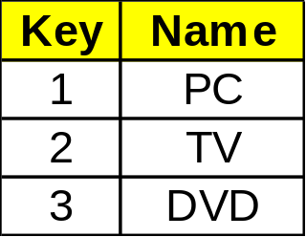
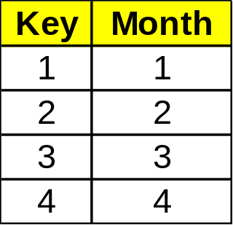
Join Index
Location
Sales
JI: Location-Product
Product
Time
IS 466 – Data Warehousing -

Slide 45
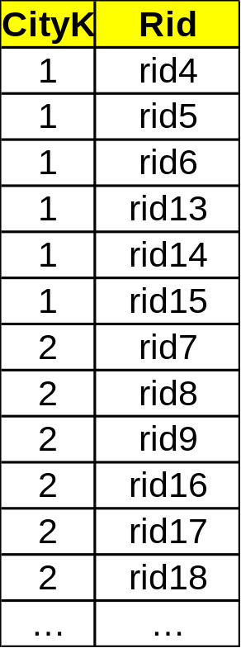
Join Index
Location
Sales
Location JI
Product
Time
IS 466 – Data Warehousing -

Slide 46
Efficient Processing of OLAP Queries
Determine which operations should be performed on the available cuboids:
  transform drill, roll, etc. into corresponding SQL and/or OLAP operations, e.g, dice = selection + projection
Determine to which materialized cuboid(s) the relevant operations should be applied.
Exploring indexing structures and compressed vs. dense array structures in MOLAP
IS 466 – Data Warehousing -

Slide 47
Data Warehouse Utilities
Data extraction:
  get data from sources
Data cleaning:
  detect errors in the data and rectify them when possible
Data transformation:
  convert data from host format to warehouse format
Load:
  sort, summarize, consolidate, compute views, check integrity, and build indices and partitions
Refresh:
  propagate the updates from the data sources to the warehouse
IS 466 – Data Warehousing -

Slide 48
Complex Aggregation at Multiple Granularities: Multi-Feature Cubes
Multi-feature cubes (Ross, et al. 1998): Compute complex queries involving multiple dependent aggregates at multiple granularities
Ex. Grouping by all subsets of {item, region, month}, find the maximum price in 2000 for each group, and the total sales among all maximum price tuples
  select item, region, month, max(price), sum(R.sales)
  from sales
  where year = 2000
  cube by item, region, month: R
  such that R.price = max(price)
IS 466 – Data Warehousing -

Slide 49
From On-Line Analytical Processing to On Line Analytical Mining (OLAM)
OLAM integrates OLAP with Data mining
Why OLAM?
  High quality of data in data warehouses
    DW contains integrated, consistent, cleaned data
  Available information processing structure surrounding data warehouses
    ODBC, OLEDB, Web accessing, service facilities, reporting and OLAP tools
  OLAP-based exploratory data analysis
    mining with drilling, dicing, pivoting, etc.
  On-line selection of data mining functions
    integration and swapping of multiple mining functions, algorithms, and tasks.
IS 466 – Data Warehousing -

Slide 50
Mining query
Mining result
Layer4
User Interface
User GUI API
OLAM
Engine
OLAP
Engine
Layer3
OLAP/OLAM
Data Cube API
Layer2
MDDB
MDDB
Meta Data
Filtering&Integration
Database API
Filtering
Layer1
Data Repository
Data cleaning
Data
Warehouse
Databases
Data integration
IS 466 – Data Warehousing -

